Slide 1


Ala Marar
05/12/2024

Slide 2

Outline
Executive Summary
Introduction
Methodology
Results
Conclusion
Appendix

Slide 3
Summary of methodologies
Summary of all results
Executive Summary
Objective: Predict the success of Falcon 9 first stage landings.
Process
Data Collection: Webscraped Falcon 9/Heavy launch data from Wikipedia/SpaceX.
Data Wrangling: Cleaned and formatted data for analysis.
Exploratory Data Analysis (EDA): Identified patterns and defined labels for supervised learning.
Database Integration: Loaded dataset into a SQL database for advanced queries.
Feature Engineering: Developed features to enhance predictive accuracy.
Interactive Visualizations: Utilized Folium for geospatial insights and created a dashboard with Dash.
Machine Learning Pipeline: Built and evaluated models for landing predictions.
Insights Gained: Our analysis indicates correlations between launch features and outcomes, with Decision Tree emerging as the most effective algorithm for predicting Falcon 9 first-stage landing success.
Github Repo: Link

Slide 4
Project background and context
Problems you want to find answers
Introduction
SpaceX and Falcon 9
SpaceX revolutionized space exploration with reusable rockets.
Falcon 9 first stage landings are crucial for cost efficiency and sustainability.
SpaceX pricing is around $62 million vs $165 million normally
Problem Statement
Determining the likelihood of a successful first-stage landing remains complex.
Accurate predictions can inform design, planning, and mission strategy.
Project Objective
Build a predictive model to determine if the Falcon 9 first stage will successfully land, using historical launch data. This information can be used if an alternate company (Space Y) wants to bid against SpaceX for a rocket launch.
Main Question: For a set of features related to a Falcon 9 rocket launch (such as payload mass, flight number, orbit type and more), will the first stage of the rocket land successfully?

Slide 5

Section 1

Slide 6
Executive Summary
Data collection methodology:
Describe how data was collected
Perform data wrangling
Describe how data was processed
Perform exploratory data analysis (EDA) using visualization and SQL
Perform interactive visual analytics using Folium and Plotly Dash
Perform predictive analysis using classification models
How to build, tune, evaluate classification models
Methodology – Data Collection
Data Source: Space X API and Wikipedia Falcon 9 and Falcon Heavy launch records.
Tools Used:
Python Libraries: Helper functions, Beautiful Soup.
HTTP Requests: Retrieved data using a GET request.
Data Extraction:
Extracted HTML tables containing launch data.
Parsed table headers to identify variable names.
Filtering:
Retained only Falcon 9 launches for analysis.
Data Cleaning:
Ensured correct data types for all variables.
Identified and addressed missing data.
Replaced missing values in Payload Mass with the mean.

Slide 7
Data Collection – SpaceX API
API Data
The API used for SpaceX data is https://api.spacexdata.com/v4
From the API we extract the Booster Version, LaunchSite, PayloadData and Core Data
Gives us 90 rows and 17 features
Github URL: Link
Request from SpaceX API
Filter to retain relevant columns
Construct dataset by combining features
Parse response with json_normalize()
Use functions to extract key info.
Filter data to keep only Falcon 9
Deal with missing values, replace missing payload values with mean

Slide 8
Data Collection – Web Scraping
Wikipedia Data
We web scrape data from https://en.wikipedia.org/w/index.php?title=List_of_Falcon_9_and_Falcon_Heavy_launches&oldid=1027686922
Gives us 121 rows and 11 features
Github URL: Link
Scrape HTML data from Wikipedia
Use HTML headers to find launch information
Extra data to by iterating through table
Parse HTML file using Beautiful Soup
Set up Pandas DataFrame
Finalize Dataset

Slide 9
Methodology - Data Wrangling
We create a landing outcome class label where a landing was successful (1) and where it was a failure (0)
This is done based on the outcome column. The outcome column would have both the outcome component and the landing location component.
We use this to determine a column label a a training label
Github URL: Link

Slide 10
Methodology – EDA with Visualization
Data Exploration:
• Counted launches by site.
• Analysed frequency and types of orbits.
• Examined mission outcomes for each orbit.
Visualizing Patterns:
• Flight Number vs. Launch Site: Explored for successful and failed outcomes.
• Payload Mass vs. Launch Site: Analyzed for success and failure patterns.
• Used Scatter plots, bar plots, and line plots to help assess the relationship between variables
Orbit Analysis:
• Examined success rates by orbit type.
• Investigated the relationship between flight number, orbit type, and success likelihood.
Temporal Trends:
• Analysed changes in success rates and patterns over time (years).
Github URL: Link

Slide 11
EDA with SQL
Loaded data into IBM DB2 Database
Queried data from database using SQL Lite
Used SQL to understand the data further before predictive analysis
SQL Analysis:
• Identified boosters with the highest successful landings.
• Calculated failures and successes by month.
• Counted occurrences of different outcomes.
Github URL: Link

Slide 12
Methodology – Interactive Visualization with Folium
Interactive Mapping:
Plotted launch sites on an interactive map using Folium.
Marked launch sites based on success or failure outcomes.
Proximity Analysis:
Calculated distances between launch sites and nearby features (e.g., railways, highways, coastlines, cities).
Visualised the possible the impact of proximity on launch success or failure.
Objects added:
Markers for all launch sites on the map, succeeded/failed launches, line for distances to major points, and a longitude and latitude marker for your mouse (cursor)
Github URL: Link

Slide 13
Build a Dashboard with Plotly Dash
Dashboard Creation:
Created a dashboard with dropdown functionality to help visualise the data. This was done with Dash.
Visualisations created:
We display the total successful launches from the different launch sites. This is done with a pie chart.
We display the correlation between mission outcome and the payload mass to help us identify if there is a relationship between mass and outcome. This is done with a scatter plot.
Customisability
The dashboard allows users to choose a specific launch site to manipulate the pie chart and see its success rate.
GitHub URL: Link

Slide 14
Methodology – Predictive Analysis Preparation
Feature Engineering:
• Created dummy categorical variables for non-numeric features.
• Corrected variable types, e.g., converting numeric columns to floats.
Data Standardization:
• Standardized the data to ensure consistent scale for model training.
Data Splitting:
• Divided data into training and testing sets for model evaluation.
Ready for Predictions:
• Data is now prepared for machine learning model training and testing.

Slide 15
Methodology – Predictive Analysis
Model Creation & Hyperparameter Tuning:
• Logistic Regression: Used GridSearchCV to find the best parameters.
• Support Vector Machine (SVM): Tuned hyperparameters using GridSearchCV.
• Decision Tree Classifier: Optimized with GridSearchCV for best parameters.
• K-Nearest Neighbours (KNN): Tuned using GridSearchCV for optimal performance.
Model Evaluation:
• Tested each model on the test data.
• Visualized accuracy scores to determine the best-fitting model.

Slide 16
Methodology – Predictive Analysis
Split Class label
Using GridSearchCV, find best param_ for decision tree, KNN, SVM and LogReg
Split the data into the training set and the testing set
Calculate accuracy scores and create confusion matrices
Use standard scalar to transform data
Assign cv=10 to the GridSearchCV
Bar Chart with accuracy scores for model comparison
GitHub URL: Link

Slide 17
Results
The results are now going to be split in several sections:
Exploratory data analysis results
Interactive analytics demo in screenshots (Plotly and Dash)
Predictive analysis results

Slide 18

Section 2

Slide 19
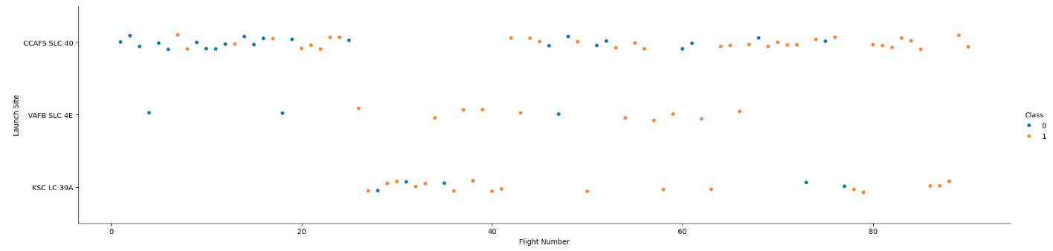
Flight Number vs. Launch Site
This is a scatter plot of Flight Number vs. Launch Site where the class indicates success (1 - orange) or failure (0 - blue)
We can see that at the highest flight numbers (above 80) the success rate is 100%
We can see that below 10 the failure rate is quite high for the CCAFS SLC 49

Slide 20
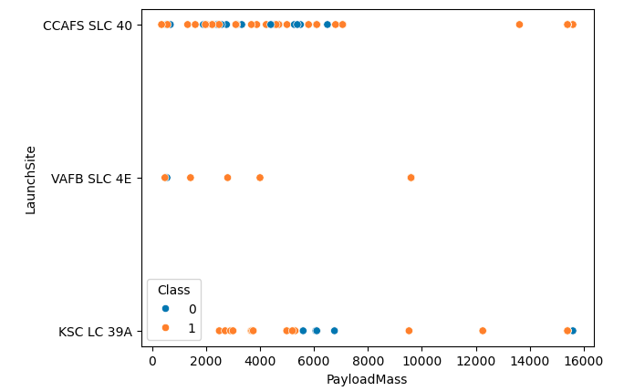
Payload vs. Launch Site
This is a scatter plot of Payload vs. Launch Site. Where class indicates success / failure
We can see that for CCAFS SLC 40 launchsite, they have a higher success rate at above 6000KG payload
We can see that VAFB SLC 4E has the highest success rate.

Slide 21
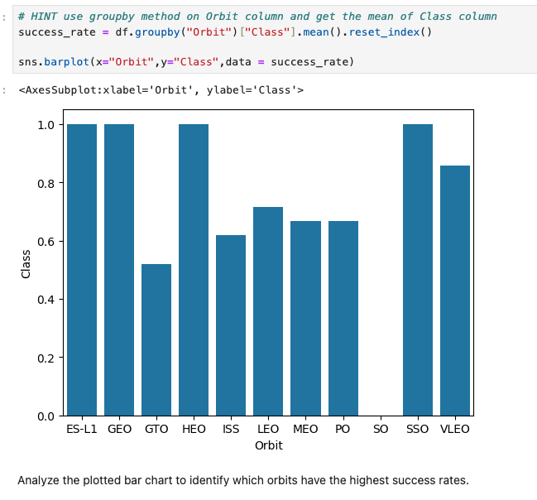
Success Rate vs. Orbit Type
This is a bar chart for the success rate of each orbit type
We can see that SSO, HEO, GEO and ES-L1 have the highest success rate
We can see that SO has a 100% failure rate.

Slide 22
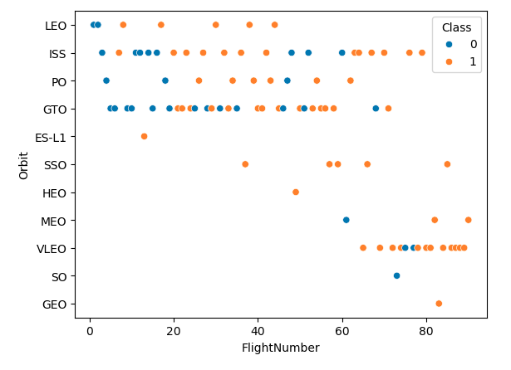
Flight Number vs. Orbit Type
This is a scatter plot of Flight number vs. Orbit type, where class indicates success/failure
We can see that for LEO and MEO, the higher the flight number the greater the success rate.
We can see that for some orbits there is no correlation between flight number and success rate

Slide 23
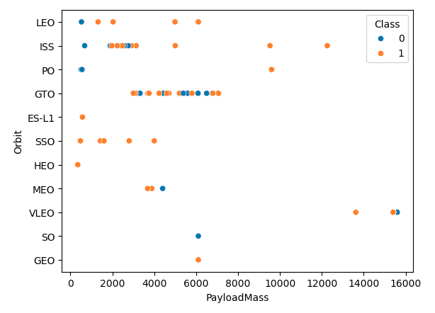
Payload vs. Orbit Type
This is a scatter plot of payload vs. orbit type. Where class 1 indicates a success.
We can see that for LEO, ISS and PO, the higher the payload mass the higher the success rate.
We can see that ES-L1, SSO, HEO, GEO have the highest success rate.

Slide 24
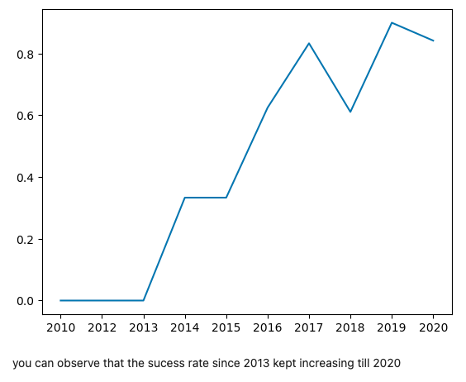
Launch Success Yearly Trend
Show a line chart of yearly average success rate
Show the screenshot of the scatter plot with explanations

Slide 25
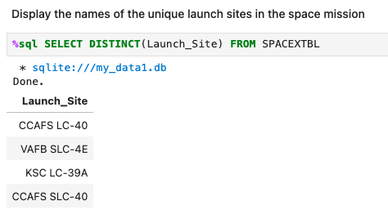
All Launch Site Names
Find the names of the unique launch sites
Present your query result with a short explanation here

Slide 26
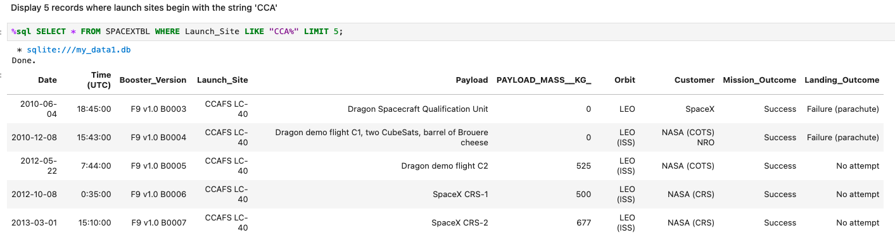
Launch Site Names Begin with 'CCA'
We extract 5 records where the name of the launch site starts with ”CCA”, we do this using the ”LIKE” method with a % after CCA. We limit the response to 5 so we only get 5 records.

Slide 27
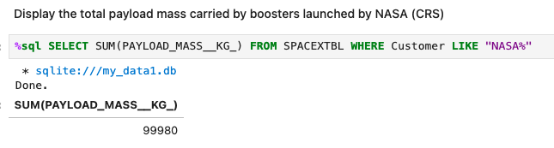
Total Payload Mass
We calculate the total payload mass by boosters that NASA launched. We do this by filtering ”Customer” to NASA, and using the SUM function in SQL on the payload mass variable. The total payload mass is 99,980KG

Slide 28
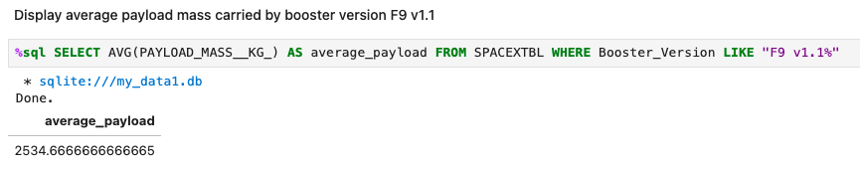
Average Payload Mass by F9 v1.1
We calculate the average payload mass for booster versions F9 v1.1. The average payload is approx. 2534.67KG

Slide 29
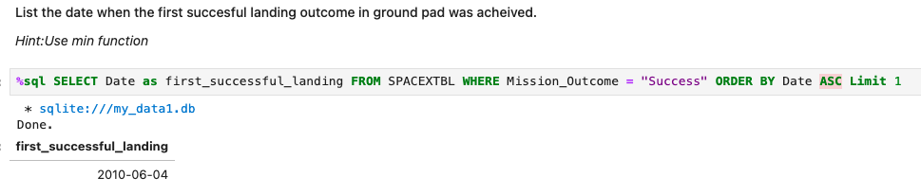
First Successful Ground Landing Date
After ordering all successful landings by date (in ascending order) we take the first record using the limit 1 method. We find the first successful landing to be on 04-06-2010.

Slide 30
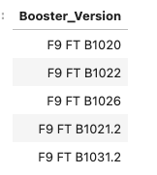

Successful Drone Ship Landing with Payload between 4000 and 6000
We list the names of boosters which have successfully landed on drone ship and had payload mass greater than 4000 but less than 6000

Slide 31
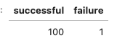
Total Number of Successful and Failure Mission Outcomes
We calculate the number of successful and failure mission outcomes. We do this by using the CASE WHEN method to filter missions for successes and failures separately. We find that there were 100 success and 1 failure.

Slide 32

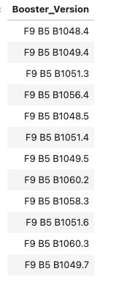
Boosters Carried Maximum Payload
We list the names of the booster which have carried the maximum payload mass
We find around 12 booster versions which have carried the maximum payload mass

Slide 33
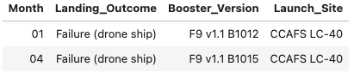
2015 Launch Records
We list the failed landing_outcomes in drone ship, their booster versions, and launch site names for in year 2015
We do this by converting strings into month format and year format. We then filter for failures and the year 2015.
We have two failures from 2015, in January and in April.

Slide 34
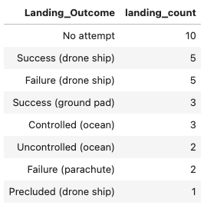
Rank Landing Outcomes Between 2010-06-04 and 2017-03-20
We rank the count of landing outcomes (such as Failure (drone ship) or Success (ground pad)) between the date 2010-06-04 and 2017-03-20, in descending order
We find the following:
launches where the landing was not attempted were the most frequent
When attempted, most landings are attempted on drone ship.
Landings on drone ship have a 50% success rate.

Slide 35

Section 3

Slide 36
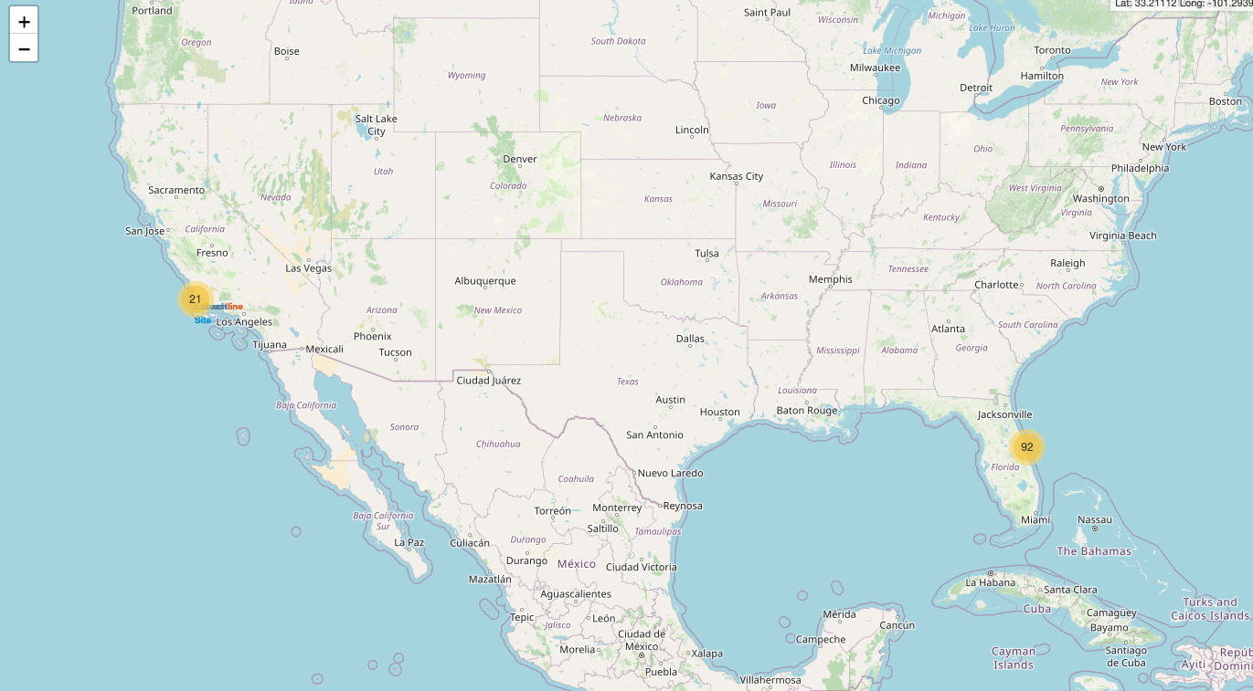
Initialize Folium Map
We first initialize the folium map and add the specific launch sites.

Slide 37
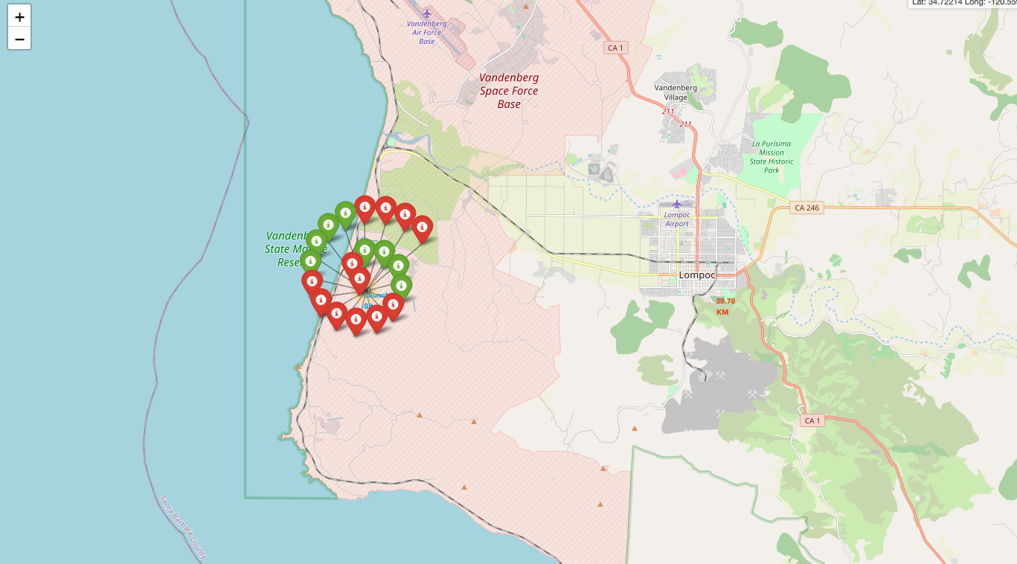
Folium Map with Success Indicator
We improve label visibility by color coding the successful vs failure launch sites.

Slide 38
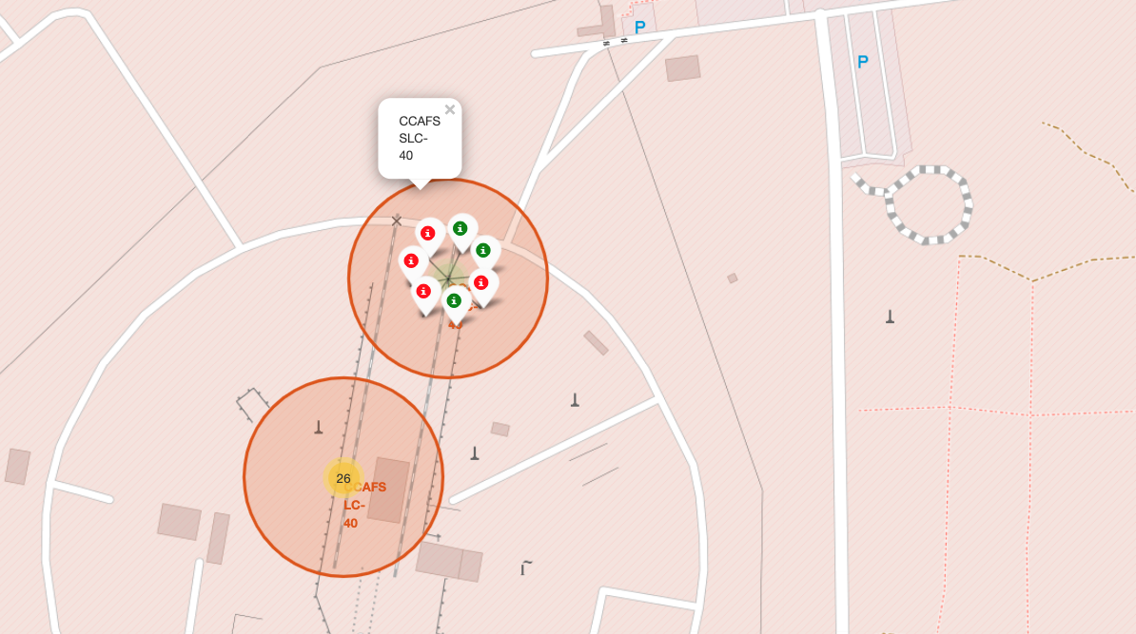
Overlaying labels and the Mouse Position
We introduce a label for the different launch site to help navigation on the map. We also introduce the mouse position so we can see the Longitude and Latitude of our mouse.

Slide 39
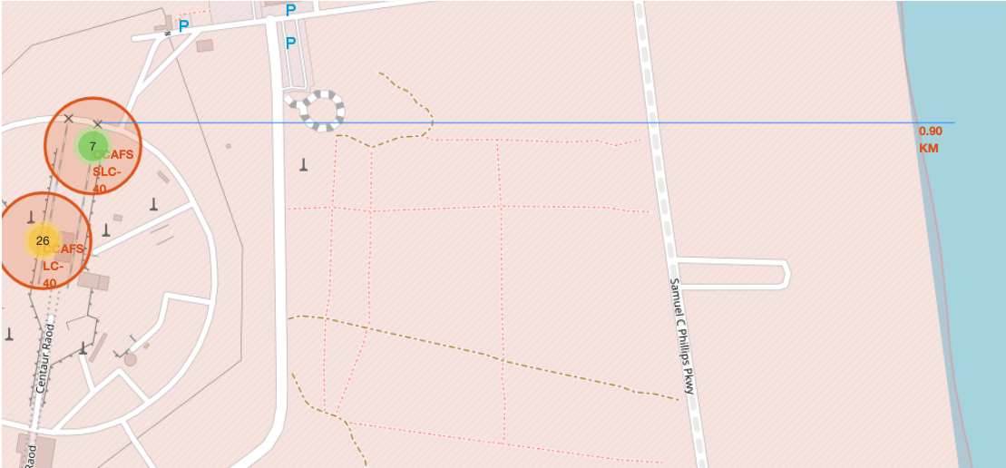
Folium Map with Proximities.
We choose a specific launch site and begin to calculate the approximate distance between it and various points, such as highways, railways and more.
In this photo, we look at the proximity from the coastline.

Slide 40

Section 4

Slide 41
Total Success Launches by All Sites
This is a pie chart indicating the percentage of successful launches by launch site.
The legend indicates the color of the respective launch site.
This is currently showing All Sites. The Launch Site KSC LC 39A is the most successful launch.

Slide 42
Success Rate for KSC LC -39A
This is a pie chart showing the proportion of successful launches for the Site KSC LC -39A
Shaded area in blue indicates the successful launches.
For the KSC LC -39A, the success rate is 76.9%

Slide 43
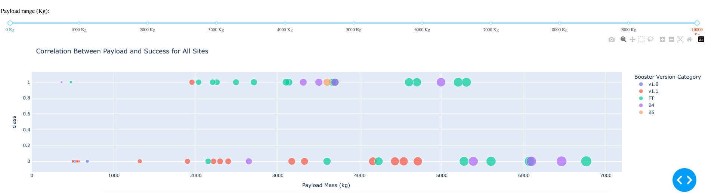
Payload Mass vs Success Rate
This shows a Payload vs. Launch Outcome scatter plot for all sites, with different payload selected in the range slider
The legend indicates the booster version category
The slider at the top allows us to constrict the payload range to manipulate the chart

Slide 44

Section 5

Slide 45
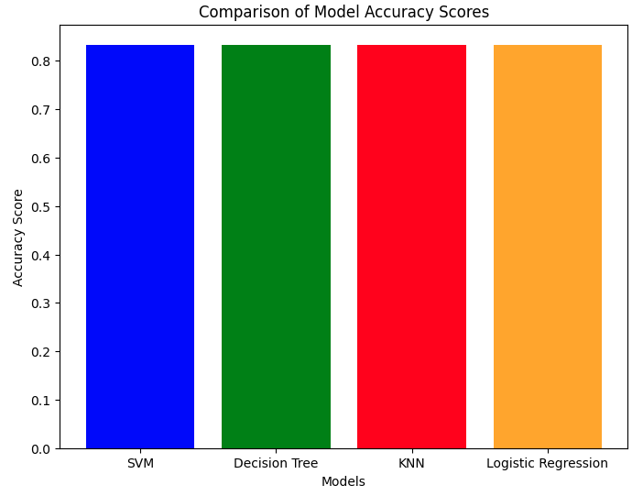
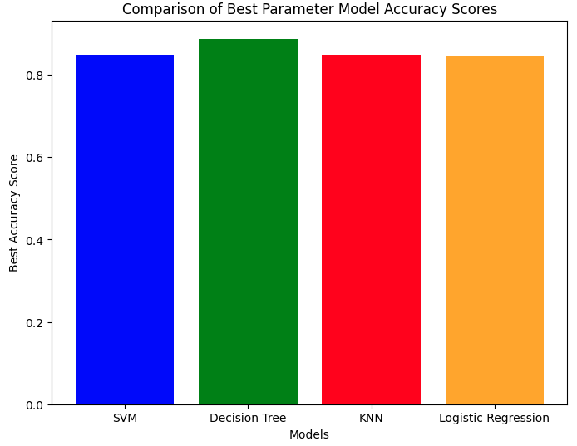
Classification Accuracy
The Decision Tree model has the best accuracy. Even though the accuracy score on the testing data appears to be the same for all models. Under the best parameters, the accuracy score on the training set is highest for the decision tree model, with a score of: 0.8875

Slide 46
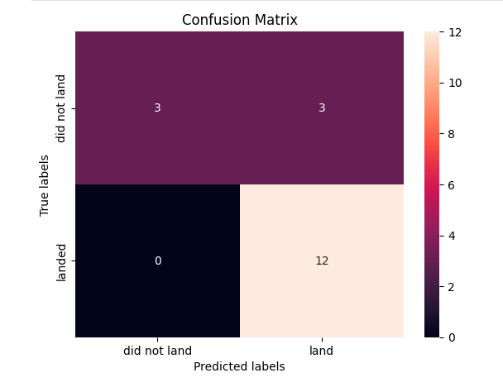
Confusion Matrix
This is the confusion matrix for the decision tree model when tested on the test data.
It shows that of the launches that landed successfully, all 12 were correctly classified by the model.
However, of the 6 that did not land, only half were correctly classified as having landed.

Slide 47
Conclusions
Summary of Findings:
Visualizations indicate possible correlations between features and mission outcomes.
Payload Mass & Orbit Type: Higher success rates observed for heavy payloads in Polar, LEO, and ISS orbits.
GTO Orbit: Success patterns are less distinct due to mixed outcomes.
Discussion:
Each feature impacts the mission outcome, though the exact relationships are complex.
Machine learning models help uncover patterns in historical data, offering predictive insights for future missions.
Project Achievements:
Built predictive models to assess Falcon 9 first-stage landing success.
Decision Tree Model: Achieved the highest accuracy among the four algorithms tested.
Conclusion:
Predictive insights contribute to estimating launch costs and optimizing mission planning, aiding SpaceX’s goal of cost-effective and sustainable space exploration.

Slide 48


